Slide 1
FAKE NEWS DETECTION USING MACHINE LEARNING
ANJALI GAUR

Slide 2
INTRODUCTION
The advent of the World Wide Web and the rapid adoption of social media platforms (such as Facebook and Twitter) paved the way for information dissemination that has never been witnessed in the human history before. With the current usage of social media platforms, consumers are creating and sharing more information than ever before, some of which are misleading with no relevance to reality. Automated classification of a text article as misinformation or disinformation is a challenging task. Even an expert in a particular domain has to explore multiple aspects before giving a verdict on the truthfulness of an article. In this work, we propose to use machine learning ensemble approach for automated classification of news articles.

Slide 3
OBJECTIVE
>To identify the fake news using data mining perspective
>To learn and apply the various machine learning algorithms
>To compare the performance of the system using different machine learning algorithm
PURPOSE
>Understanding multiple algorithm
>Knowledge in machine learning
>To identify whether the news is fake or real
SCOPE
>once a source is labeled as a procedure of a fake news ,we can predict with high confident that any future articles from that source will also be faked

Slide 4
MACHINE LEARNING
Machine learning (ML) is the study of computer algorithms that can improve automatically through experience and by the use of data. It is seen as a part of artificial intelligence . Machine learning algorithms build a model based on sample data, known as "training data", in order to make predictions or decisions without being explicitly programmed to do so. Machine learning algorithms are used in a wide variety of applications, such as in medicine, email filtering, speech recognition, and computer vision, where it is difficult or unfeasible to develop conventional algorithms to perform the needed tasks.

Slide 5
ALGORITHMS USED FOR CLASSIFICATION
A. Logistic Regression
It is a classification not a regression algorithm. It is used to estimate discrete values (Binary values like 0/1, yes/no, true/false) based on set of independent variables (s). In simple words, it predicts the probability of occurrence of an event by fitting data to a logit function. Hence, it is also known as logit regression. Since, it predicts the probability, its output values lie between 0 and 1 (as expected).

Slide 6
B. Decision Tree A decision tree is a flowchart-like tree structure where an internal node represents feature (or attribute), the branch represents a decision rule, and each leaf node represents the outcome. The topmost node in a decision tree is known as the root node. It learns to partition on the basis of the attribute value. It partitions the tree in recursively manner call recursive partitioning nodes in a decision tree with its leaves to minimize the number of tests in the convinced path. Usually, the subtree raising is of a modest impact on the models of the decision tree. Typically, there is no exact way to predict an option's utility, although it can be advisable to turn it off when the induction procedure takes longer because of the subtree's raising being relatively computationally complicate C. Random Forest Random forest classifier creates a set of decision trees from a randomly selected subset of the training set. It is basically a set of decision trees (DT) from a randomly selected subset of the training set and then It collects the votes from different decision trees to decide the final prediction. Random forests are a significant innovation of the bagging in which it forms a large group of de-correlated trees, and after that, take an average for them. Random Forest enhanced on bagging through decreasing correlation between trees with no increase in the variance. In many situations, the random forest performance is like boosting in which they are simpler to be trained and tuned. As a result, random forests are widespread algorithms that are applied to various packages.

Slide 7
D.Gradient Boosting Classifier
Gradient boosting classifiers are a group of machine learning algorithms that combine many weak learning models together to create a strong predictive model. Decision trees are usually used when doing gradient boosting. The objective of Gradient Boosting classifiers is to minimize the loss, or the difference between the actual class value of the training example and the predicted class value. It isn't required to understand the process for reducing the classifier's loss, but it operates similarly to gradient descent in a neural network.
MANUAL TESTING
Manual testing is the process of manually testing software for defects. It requires a tester to play the role of an end user whereby they use most of the application's features to ensure correct behaviour.
In the project we also uses manual testing that helps us to check the news is fake or real .

Slide 8
System Architecture
DATA SET
Pre-processing the data
)
Feature Extraction
Training the classifier
Fake opinion
Truthful opinion

Slide 9
DATASETS
includes both fake and truthful news articles from multiple domains. The truthful news articles published contain true description of real world events, while the fake news websites contain claims that are not aligned with facts. The conformity of claims from the politics domain for many of those articles can be manually checked with fact checking websites such as politifact.com and snopes.com. We have used three different datasets in this study, a brief description of which is provided as follows. The dataset is available at Kaggle (hereafter referred to as DS2) which contains a total of 20,386 articles used for training and 5,126 articles used for testing. The dataset is built from multiple sources on the Internet. The articles are not limited to a single domain such as politics as they include both fake and true articles from various other domains. The second dataset is also available at Kaggle (hereafter referred to as DS3); it includes a total of 3,352 articles, both fake and true. The true articles are extracted from trusted online sources such as CNN, Reuters, the New York Times, and various others, while the fake news articles are extracted from untrusted news websites. The domains it covered include sports, entertainment, and politics. A combined dataset is the collection of articles from the three datasets (hereafter referred to as DS4). As the articles vary in nature in each dataset, the fourth dataset is created to evaluate the performance of algorithms on datasets which cover a wide array of domains in a single dataset.

Slide 10
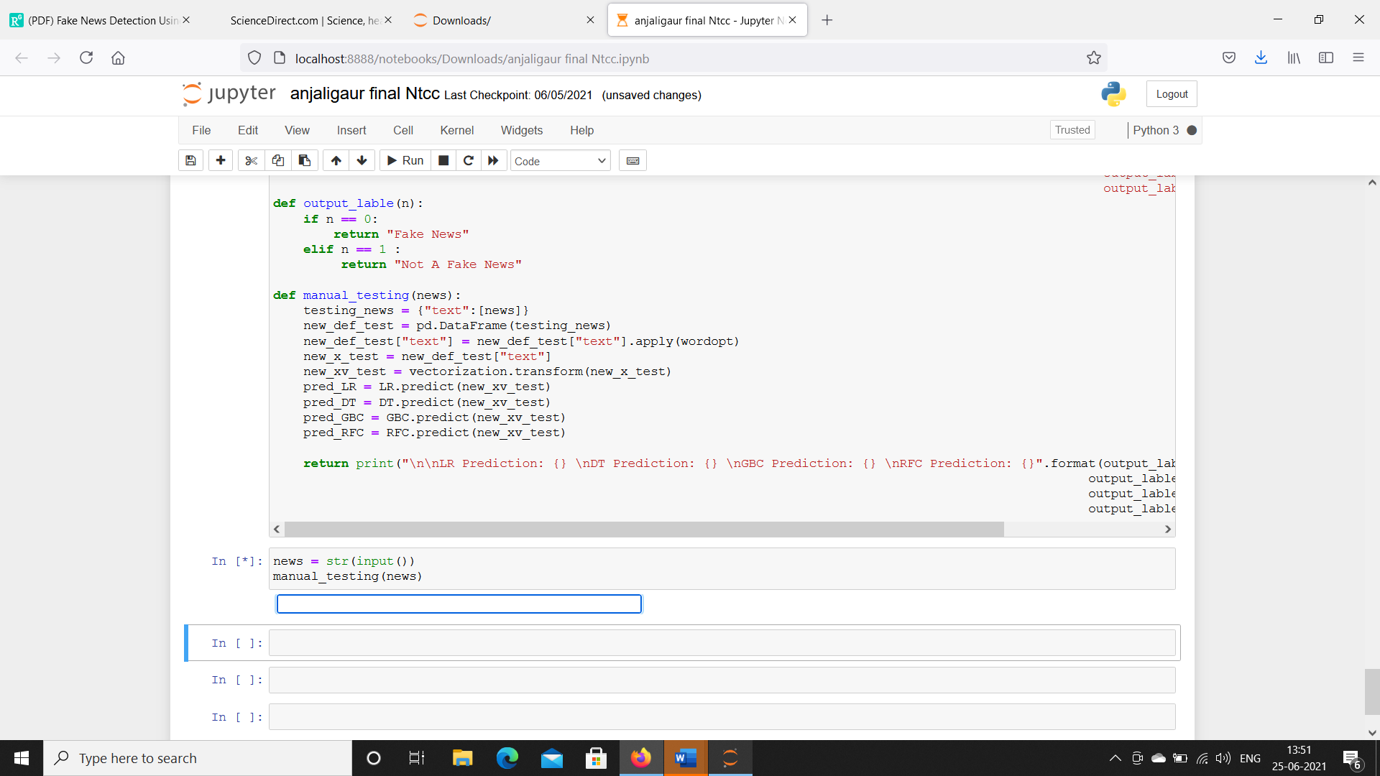
RESULT
Implementation was done using the above algorithms
Static System

Slide 11
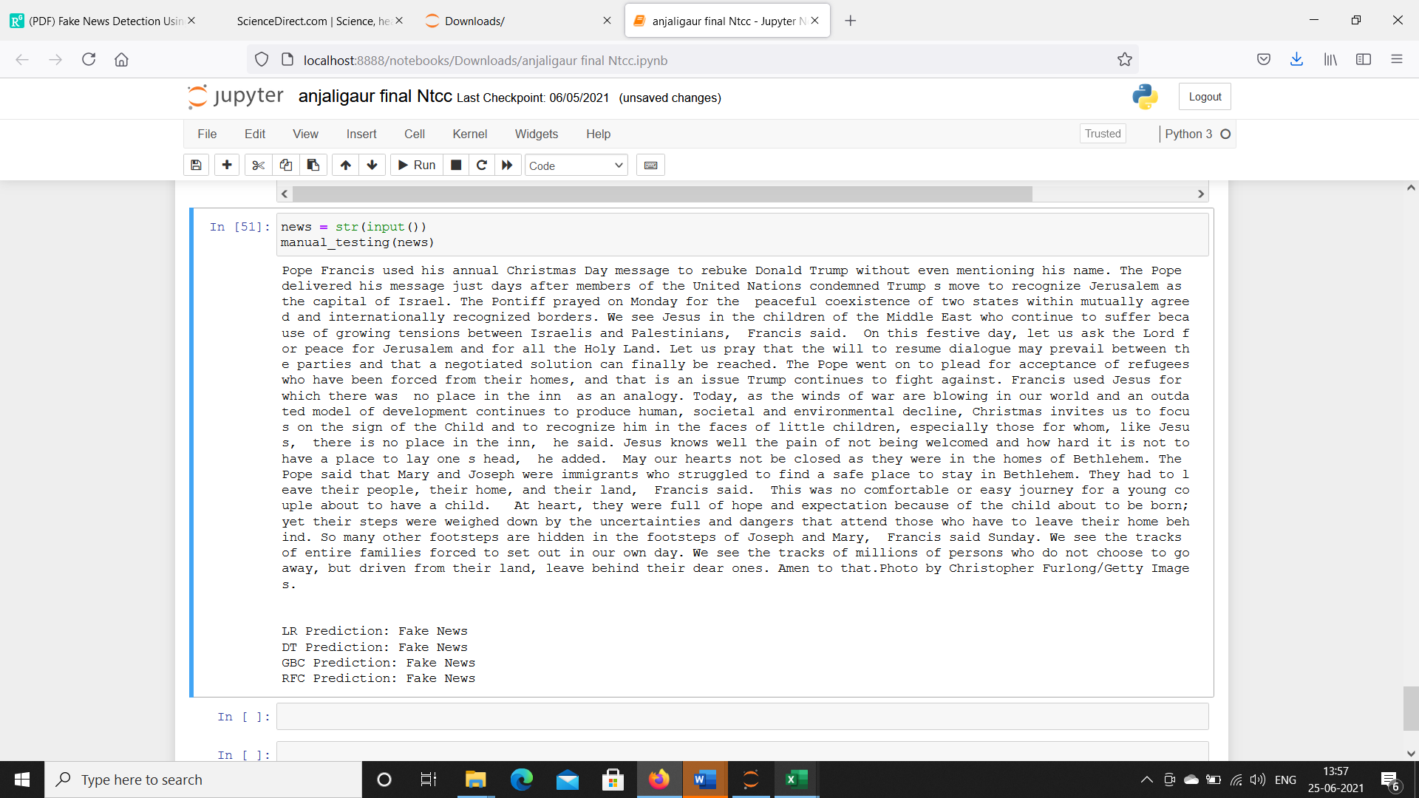
Static output that it is a fake news

Slide 12
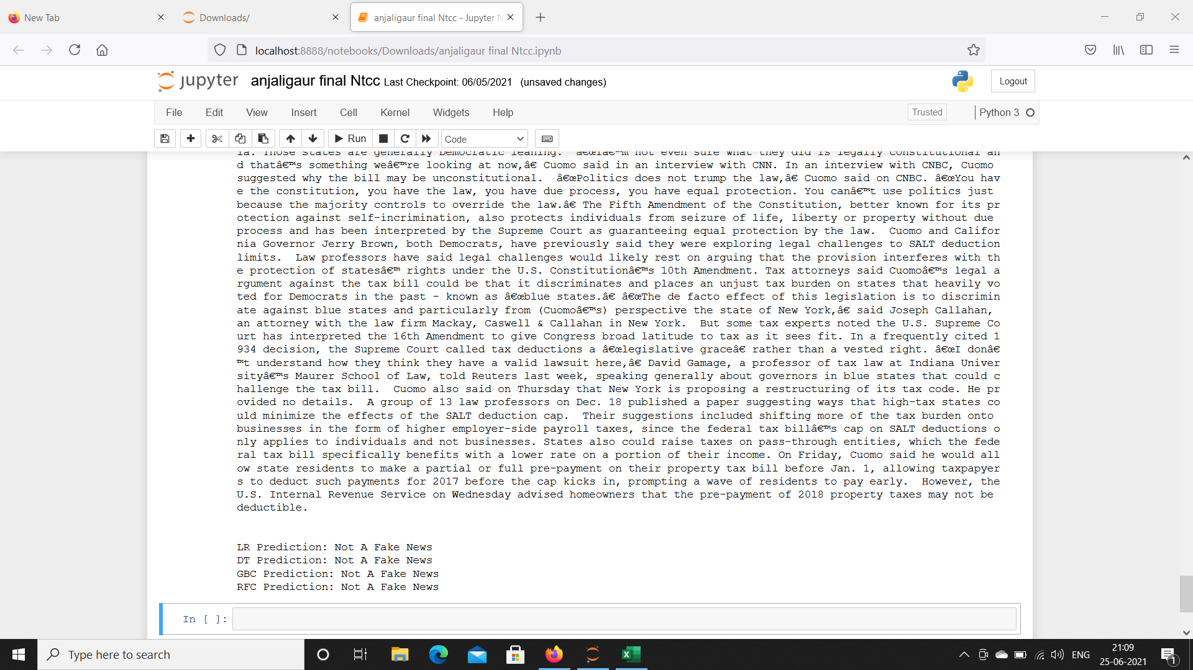
Static output is that it is not a fake news

Slide 13
CONCLUSION
The task of classifying news manually requires in-depth knowledge of the domain and expertise to identify anomalies in the text. Here , we discussed the problem of classifying fake news articles using machine learning models and ensemble techniques. The data we used in our work is collected from the World Wide Web and contains news articles from various domains to cover most of the news rather than specifically classifying political news. The primary aim is to identify patterns in text that differentiate fake articles from true news. We extracted different textual features from the articles using an LIWC tool and used the feature set as an input to the models. The learning models were trained and parameter-tuned to obtain optimal accuracy. Some models have achieved comparatively higher accuracy than others. We used multiple performance metrics to compare the results for each algorithm. The ensemble learners have shown an overall better score on all performance metrics as compared to the individual learners.
Fake news detection has many open issues that require attention of researchers. For instance, in order to reduce the spread of fake news, identifying key elements involved in the spread of news is an important step. Graph theory and machine learning techniques can be employed to identify the key sources involved in spread of fake news.

Slide 14
THANK YOU
ANJALI GAUR

